Slide 1





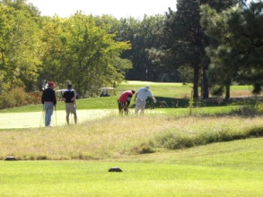

VETERANS OF FOREIGN WARS philip billard pOST 1650
18th Annual pow/mia memorial golf tournament
15 august 2026
“Silver Star Sponsor”
$200 Plus Donation
One Year Sponsor Advertisement
on Post Website.
Sponsor Display at Post 1650
Events
VFW Post 1650 Provides a Sign for
a T-box at the Tournament with
Sponsor Logo/Ad
Recognized at the Tournament
Silver Star Certificate of Support
“Bronze Star Sponsor”
$100-$199 Donation
VFW Post 1650 Provides a Sign for a T-Box at the Tournament with Sponsor Logo/Ad
Bronze Star Recognition at Tournament
Bronze Star Certificate of Support
Pledge Amount $______________________
“Meritorious Service
Sponsor”
Less than $100 Donation
Recognition at the Golf Tournament
Meritorious Service Certificate of
Support
Proceeds Benefit VFW Philip Billard Post #1650
POC: BRIAN TRITSCH Cell: 785-817-4609 text or leave msg. Post Ph 785-235-9073
---------------------------------------------------------------------------------------------------------------
Sponsor Name___________________________ Contact POC ____________________
Phone_________________________ Email __________________________________
Sponsorship Pledge Amount _________________________________________________

