Slide 1




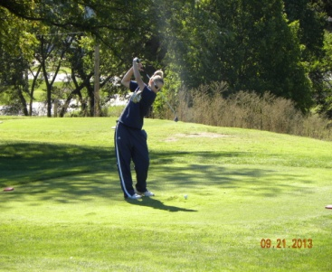
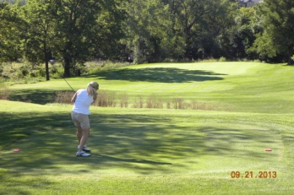

VETERANS OF FOREIGN WARS
POST #1650
18th Annual
POW/MIA Memorial Golf Tournament
VFW 1650 Golf Tournament Entry form
Please Register your Team by August 6
Team Name:
August 15, 2026
Saturday
Captain_______________________________ Player 2______________________________________
Address_______________________________ Address_____________________________________
Phone________________________________ Phone_______________________________________
Email_________________________________ Email_______________________________________
Player 3_______________________________ Player 4_____________________________________
Address_______________________________ Address_____________________________________
Phone________________________________ Phone______________________________________
Email_________________________________ Email____________________________________
______________________________________________________________________
Player entry _______ x $95 __________ () Check payable to VFW Post 1650 Golf
Veteran entry ______ x $90 __________ () Cash
Mulligans ______ x $5 __________ () Venmo Brian Tritsch
Total Paid ______________
Mail to VFW Golf Email to btritsch1@yahoo.com
2136 NW Buchanan Text 785-817-4609
Topeka, KS 66608
Or
3110 SW Huntoon
Topeka , KS 66614
19
Player 2_________________________
Address_________________________
Phone__________________________
Email___________________________
Player 4_________________________
Address_________________________
Phone__________________________
Email___________________________

