Slide 1


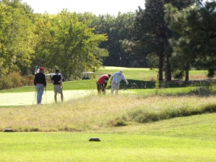


VETERANS OF FOREIGN
WARS POST 1650
POW/ MIA Golf Tournament
18th Annual
Cypress Ridge Golf
Opening Ceremony at 7:30 AM
Topeka KS
August 15, 2026
Check in Starts at 7:00 AM
8:30 AM Shot Gun Start
4 Person Scramble
$95 Per Person
$90 For Veterans.
Prize in three flights.
Hole Prizes
$500 Hole in One
Price includes Lunch, Gary Woodland Drive, 2 Mulligans per team, Green Fees, Cart.
POC: BRIAN TRITSCH
Email to btritsch1@yahoo.com
Phone Or Text:
785-817-4609
Post Ph: 785-235-9073
      Register by August 6 on entry form.
      Will accept Venmo payments for easy entry.

